Slide 1
CORE JAVA

Slide 2
Java programming language was originally developed by Sun Microsystems which was initiated by James Gosling and released in 1995 as core component of Sun Microsystems
Java is a simple programming language
Object Oriented -
Writing, compilation and debugging a program is very easy in java
It helps to create reusable code
Java has more features,
1.Object Oriented - In Java, everything is an Object. Java can be easily extended since it is based on the Object model.
2. Platform independent - During the compilation the java program converts into byte code
Using byte code we can run the application to any platform such as windows, mac, linux, etc
3. Open source - program in which source code is available to the general public for use and/or modification
from its original design at free of cost is called open source
4. Multithreading - Java supports multithreading
It enables a program to perform several task simultaneously
5. More secure - It provides the virtual firewall between the application and the computer
So it’s doesn't grant unauthorized access – No pointer, so no memory leaks.
6. Portable - "Write once run anywhere"
Java code written in one machine can run on another machine

Slide 3
Core Java concept –
1. Oops concept
2. Control statement/looping
3. Arrays
4. String
5. Exceptions
6. Collections
Write and Execute a software program
Editor – Type in Eclipse.
Compiler – to convert high level programming language in to Machine Language
Linker – to combine different program files reference into main program.
Loader – to load files from secondary storage files. Loader will automatically run when execute a code
Execution – execution done by OS and Processor in Bg

Slide 4
JDK: JRE + Dev tools.
➢ Java Development Kit
➢ If run any applications we need JDK have to installed
➢ JDK versions: 1.0 to 1.9
➢ Mostly V1.8 is used now
JRE: JVM + lib files.
➢ Java Runtime Environment
➢ It is a pre-defined. class files (i.e.) library files
JVM:
➢ Java Virtual Machine
It is mainly used to allocate the memory and compiling

Slide 5
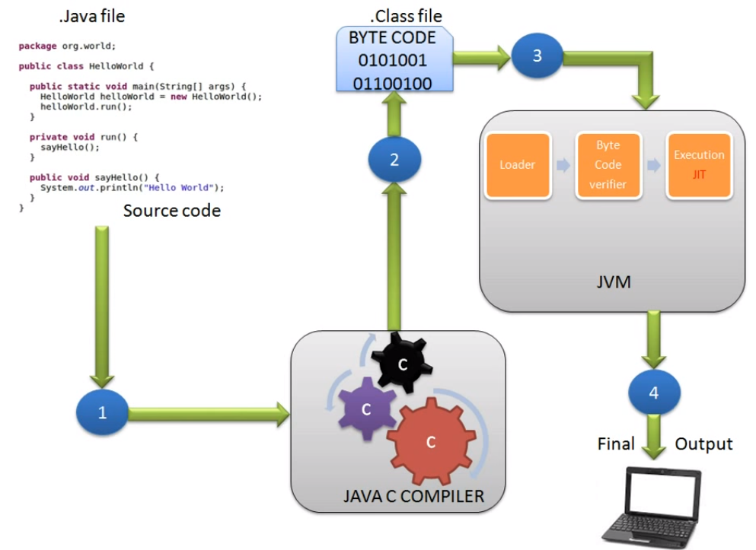
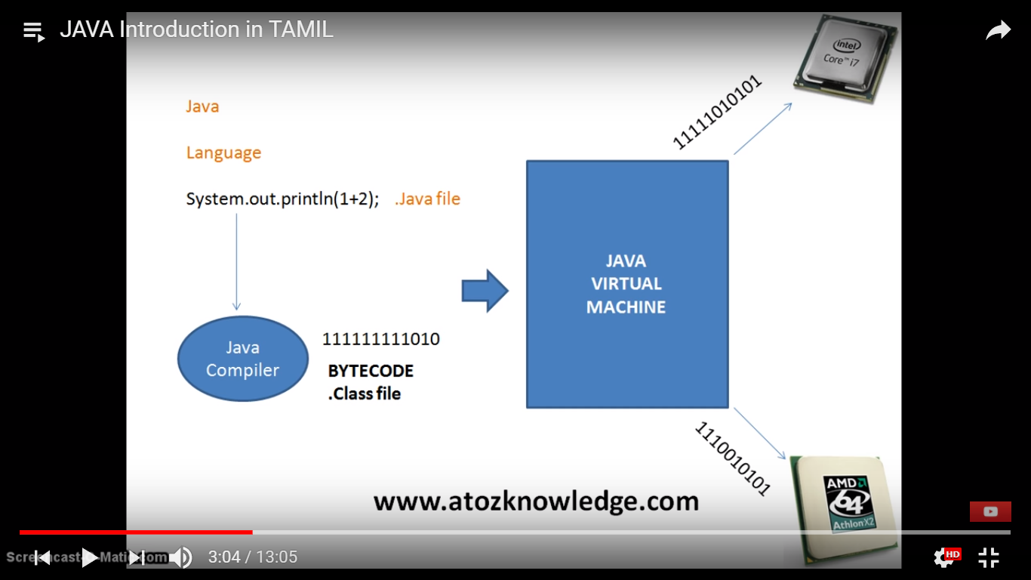

Slide 6
Oops principles are
1. Class
2. Method
3. Object
4. Abstraction
5. Encapsulation
6. Inheritance
7. Polymorphism
OOPS CONCEPT:
➢ Object Oriented Programming Structure
➢ OOPS is a method of implementation in which programs are organized as collection of objects, class
and methods

Slide 7
➢ CLASS:
Class is nothing but collection of methods or collection of objects.
A class can be defined as a template/blueprint that describes the behavior/state that the object of its type support.
➢ METHOD:
• A set of action to be performed
OBJECT:
Objects have states and behaviors. Example: A dog has states - color, name, breed as well as behaviors – wagging the tail, barking, eating. An object is an instance of a class
• Run time memory allocation
• Using object we can call the any methods

